Slide 1
Machine Learning Fundamentals
UIUC ECON 490: Applied Machine Learning in Economics

Slide 2
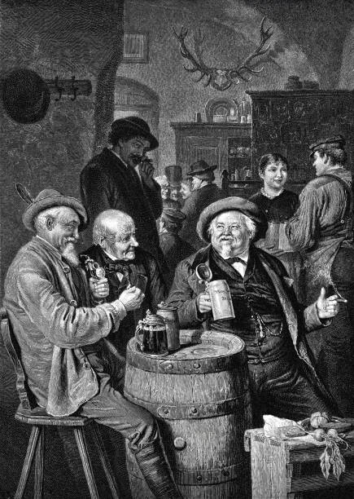

Why even bother?
Qualitative
Mercantilists:
Trade is a zero-sum game!
Quantitative
Apple: Nope.

Slide 3
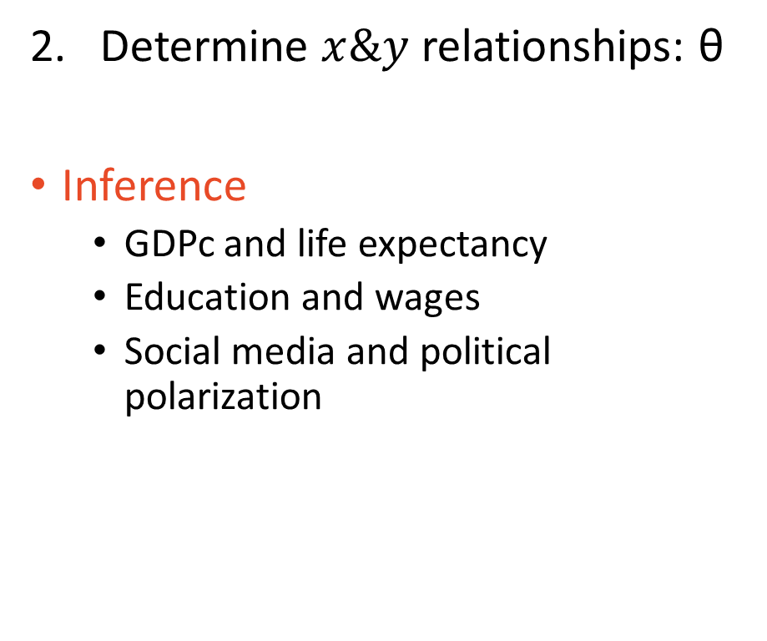
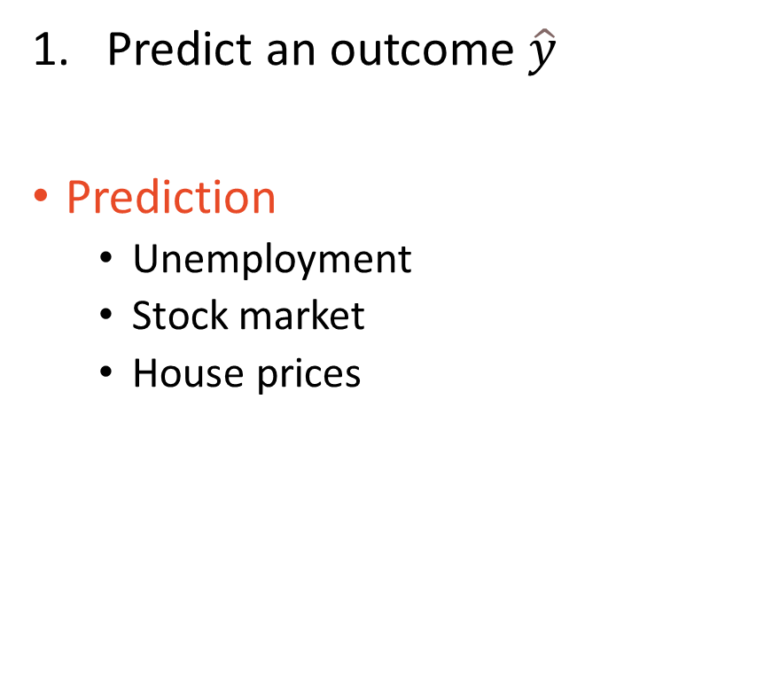
Goals of Data Analysis
Predict an outcome $\hat{y}$
Prediction
Unemployment
Stock market
House prices
Determine $x\&y$ relationships: θ
Inference
GDPc and life expectancy
Education and wages
Social media and political polarization

Slide 4
Machine Learning vs Econometrics
Machine Learning
Econometrics
Why? Economists care about policy above all else.
Prediction | Inference
Prediction | Inference

Slide 5
Model Overview: Interpretation-Flexibility Tradeoff
Models for inference:
Linear regression (OLS) – PfDA Ch13, HoML Ch4
Logistic regression (logit) – PfDA Ch13, HoML Ch4
Tree-based Models – HoML Ch6
Models for flexibility:
Naïve Bayes & K-Nearest Neighbors (KNN)
Support Vector Machines (SVM) – HoML Ch5
Ensemble Learning and Random Forests (RF) – HoML Ch7
Neural Networks (NN) – HoML Ch10–19

Slide 6

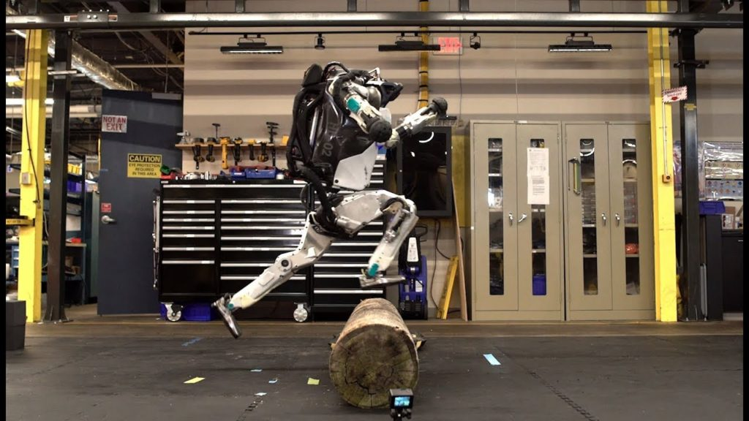
What is Learning?
Given an input, produce correct output
Taught via reinforcement

Slide 7
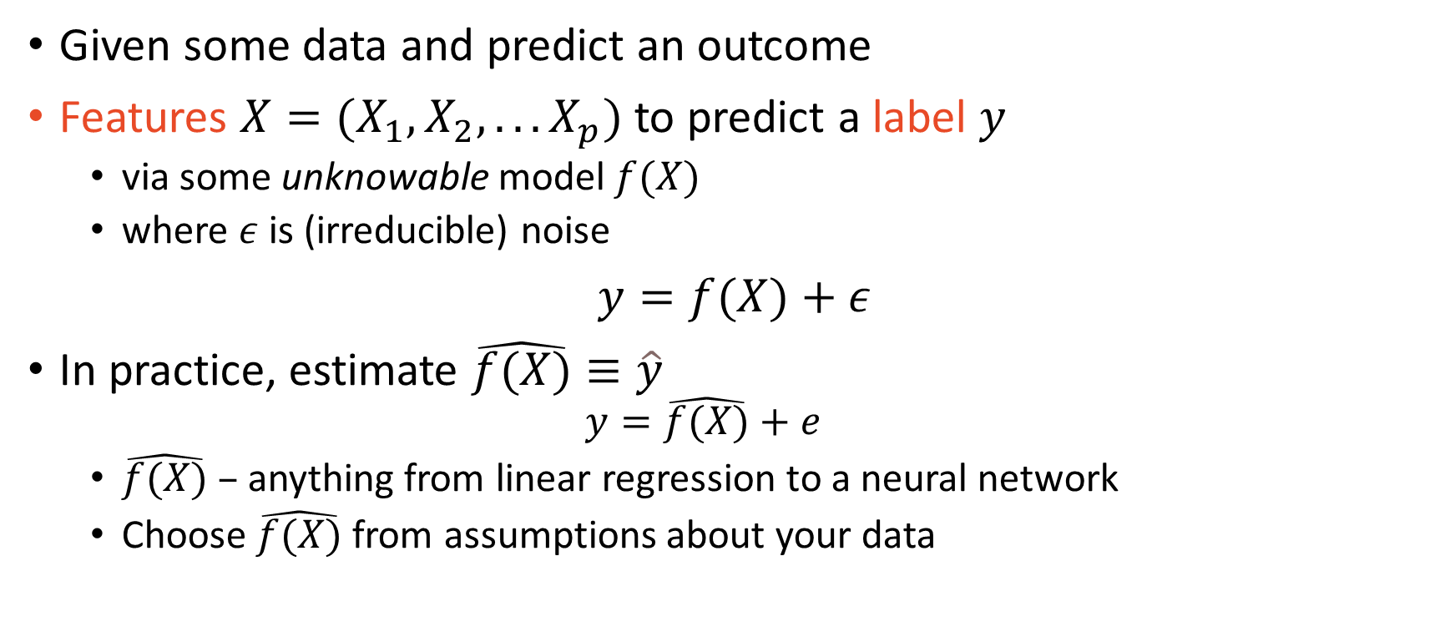
What is Machine Learning?
Given some data and predict an outcome
Features $X=(X_{1},X_{2},...X_{p})$ to predict a label $y$
via some unknowable model $f(X)$
where $ε$ is (irreducible) noise
$y=f(X)+ε$
In practice, estimate $\hat{f(X)}≡\hat{y}$
$$y=\hat{f(X)}+e$$
$\hat{f(X)}$ – anything from linear regression to a neural network
Choose $\hat{f(X)}$from assumptions about your data

Slide 8
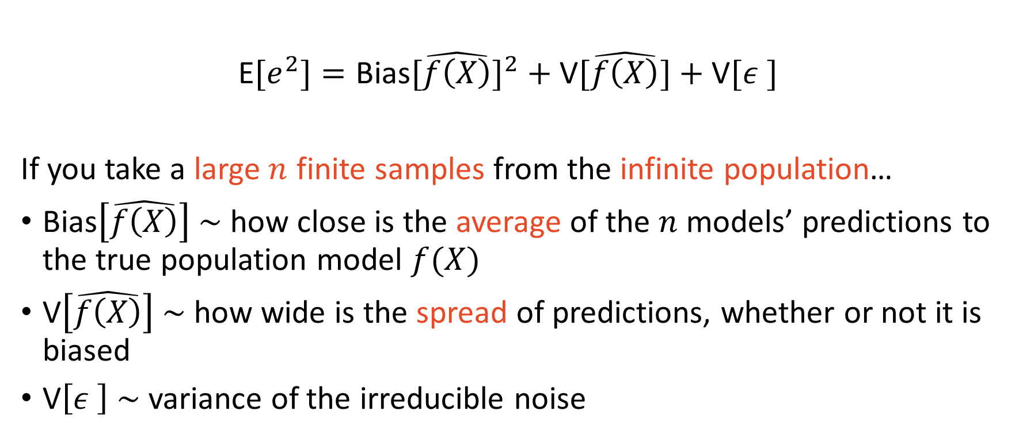
Bias-Variance Tradeoff
E$[e_{ }^{2}]=\text{Bias}[\hat{f\left(X\right)}]^{2}+\text{V}[\hat{f\left(X\right)}]+\text{V}[ε_{ }^{ }]$
If you take a large $n$ finite samples from the infinite population…
$\text{Bias}\left[\hat{f\left(X\right)}\right] \sim$ how close is the average of the $n$ models’ predictions to the true population model $f(X)$
$\text{V}\left[\hat{f\left(X\right)}\right] \sim$ how wide is the spread of predictions, whether or not it is biased
$\text{V}\left[ε_{ }^{ }\right] \sim$ variance of the irreducible noise

Slide 9
Question
Can you train a model that perfectly predicts any new sample from the population?

Slide 10
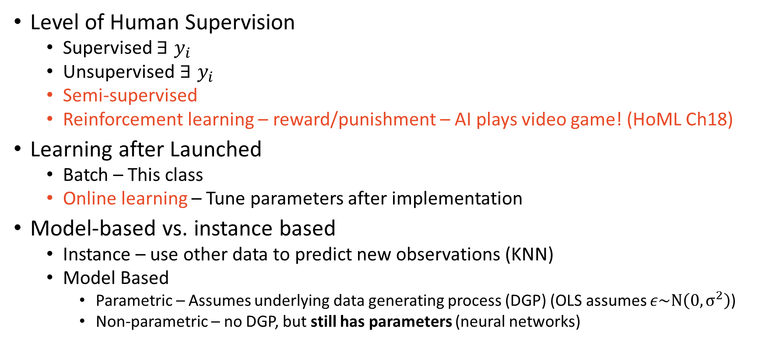
Ways Machines Can Learn (Be Trained)
Level of Human Supervision
Supervised $∃ y_{i}$
Unsupervised $∃ y_{i}$
Semi-supervised
Reinforcement learning – reward/punishment – AI plays video game! (HoML Ch18)
Learning after Launched
Batch – This class
Online learning – Tune parameters after implementation
Model-based vs. instance based
Instance – use other data to predict new observations (KNN)
Model Based
Parametric – Assumes underlying data generating process (DGP) (OLS assumes $ε\sim N\left(0,σ^{2}\right)$)
Non-parametric – no DGP, but still has parameters (neural networks)

Slide 11
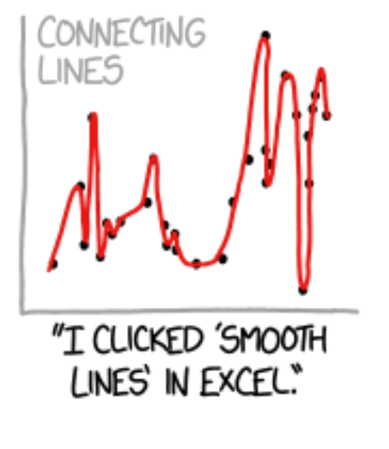
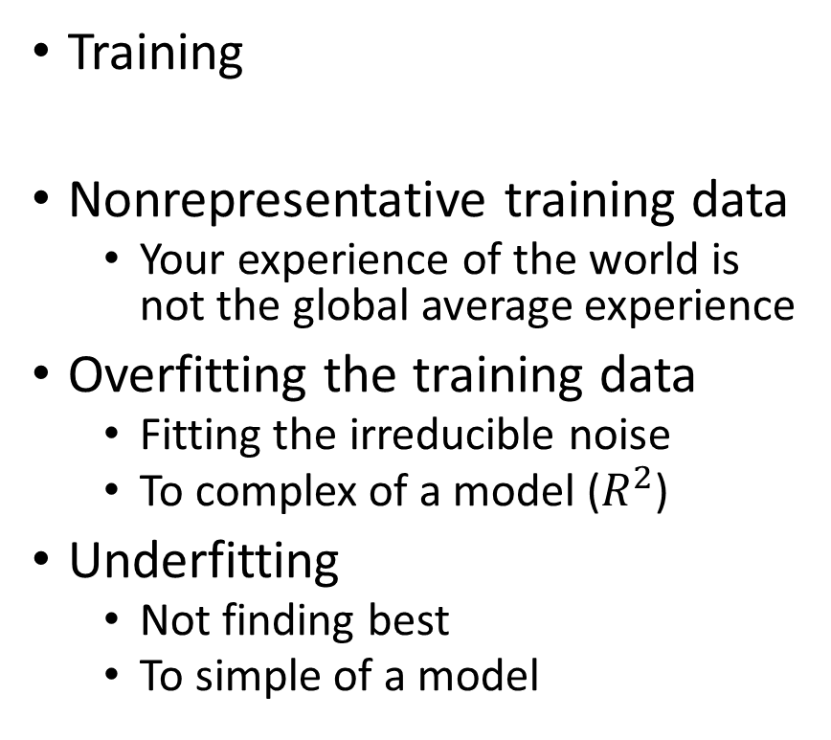
Challenges of Machine Learning
Data
Insufficient quantity of data
ML is data hungry!
Especially NN
Poor quality data
Noisy/measurement error
Ex) survey data
Irrelevant features
Garbage in, garbage out
“Feature engineering”
Training
Nonrepresentative training data
Your experience of the world is not the global average experience
Overfitting the training data
Fitting the irreducible noise
To complex of a model ($R^{2}$)
Underfitting
Not finding best
To simple of a model

Slide 12

No Free Lunch Theorem
One model does not fit all (well, you can fit any model to any data)
Linear regression may outperform a neural network
There is no “one model”

Slide 13
The Machine Learning Workflow (HoML Ch2)
Look at the big picture
Get the data
Prepare data for analysis
Discover and visualize the data to gain insights
Model selection, training, and performance
Consider alternative model (repeat 5-6) and compare
Present solution
Launch, monitor, and maintain your system

Slide 14
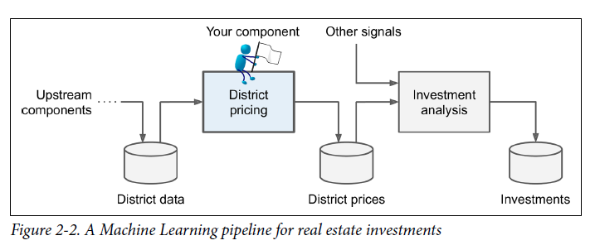
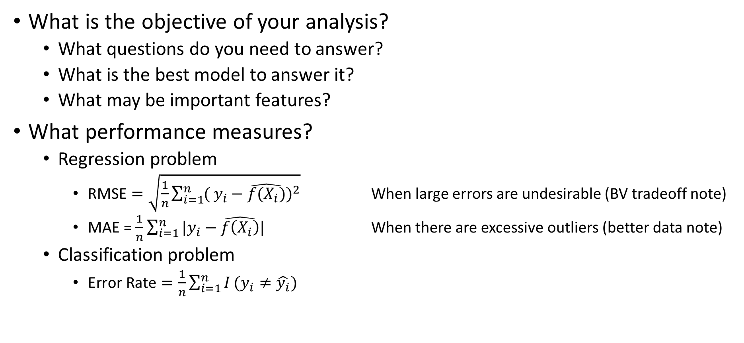
1) Look at the Big Picture
What is the objective of your analysis?
What questions do you need to answer?
What is the best model to answer it?
What may be important features?
What performance measures?
Regression problem
$\text{R}\text{MSE}=\sqrt{\frac{1}{n}\sum_{i=1}^{n}{(}y_{i}−\hat{f(X_{i})})^{2}}$ When large errors are undesirable (BV tradeoff note)
MAE = $\frac{1}{n}\sum_{i=1}^{n}{|y_{i}−\hat{f\left(X_{i}\right)}|}$ When there are excessive outliers (better data note)
Classification problem
$\text{Error} \text{Rate}=\frac{1}{n}\sum_{i=1}^{n}{I}(y_{i}≠\hat{y_{i}})$

Slide 15
2) Get the Data
Create a virtual environment for your project
Version control of software and packages (bundles of functions)
A software playpen – “now play nice, children”
Download the data
What features are important inputs?
Would you benefit from multiple data sources?
Look at the structure of the data
Are categorical variables provided as numbers (ex. 1 = male, 17 = Illinois)?
Are there codes for missing values (ex. 9999999, “na”, “.”)?
Do some continuous values have text (ex. “12,345” vs 12345)?

Slide 16
3) Prepare data for analysis
Wrangling
Correctly organizing the data
Ensure each column is a variable and each row is an observation
Merge or join the multiple data sets together
Cleaning
Changing classes (ex, 17 to “Illinois” or 17 to “17”)
Dealing with bad NAs / flags
Dealing with missing values
Convert categorical to dummy variables
From: student = [yes no yes yes]
To: student = [1 0 1 1]

Slide 17
4) Discover and visualize the data to gain insights
Exploratory Data Analysis (EDA)
Summary statistics
Produce correlation tables
Produce summary statistics
Identify and describe clusters
Plots
Univariate plots – identify transformations (ex. logarithm)
Bivariate plots – identify functional transformations (ex. polynomial)
Learn what your problem looks like

Slide 18
5) Model selection, training, and performance
Set aside a test set. Don’t touch it. Don’t look even look at it!
Model selection
What assumptions are you making about your data?
How many observations do you have?
How many features do you have?
Training
Fit on training data and evaluate performance measures
Cross-validate – set aside a validation set from the training data
Tune hyperparameters (chosen by researcher)
Performance
Evaluate on the test set

Slide 19
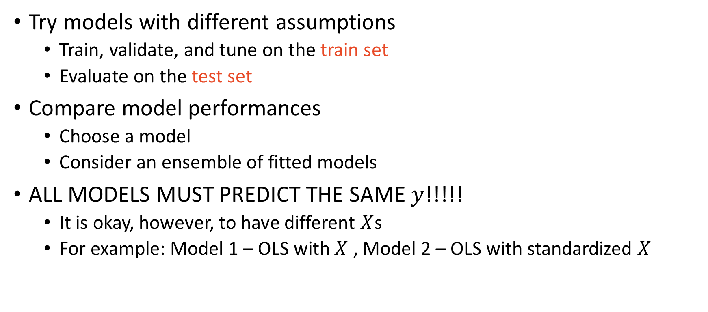
6) Consider and compare alternative models
Try models with different assumptions
Train, validate, and tune on the train set
Evaluate on the test set
Compare model performances
Choose a model
Consider an ensemble of fitted models
ALL MODELS MUST PREDICT THE SAME $y$!!!!!
It is okay, however, to have different $X$s
For example: Model 1 – OLS with $X$ , Model 2 – OLS with standardized $X$

Slide 20
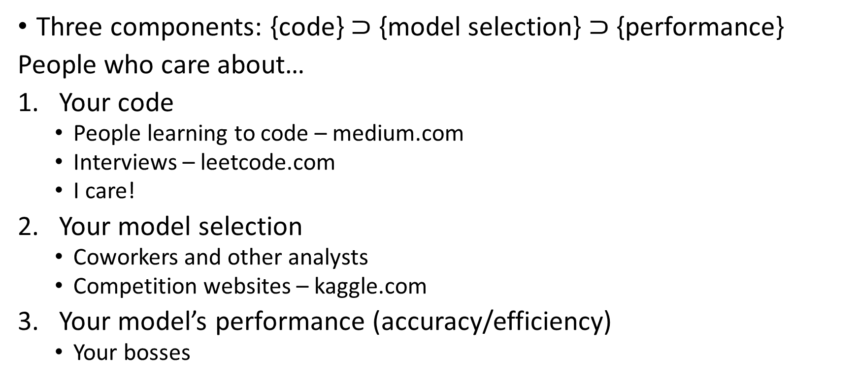
7) Present solution
Three components: {code} $⊃$ {model selection} $⊃$ {performance}
People who care about…
Your code
People learning to code – medium.com
Interviews – leetcode.com
I care!
Your model selection
Coworkers and other analysts
Competition websites – kaggle.com
Your model’s performance (accuracy/efficiency)
Your bosses

Slide 21
8) Launch, Monitor, and Maintain Your System
Launch on a website or mobile platform
Monitor performance in “the wild”
Recall to tune your system
Alternative consider online learning

Slide 22
Next Time on So You Want to Teach Machines:
Git and GitHub!
Download Git
Create a GitHub account (I recommend a personal email)
Download Atom
If you haven’t done so, Download Anaconda

